Slide 1
Automation Testing
ZL Chen, SIoT DQA, Advantech

Slide 2
Agenda
Automation Testing Functional
Automation Testing Tools
Long-Term
Process
Continuous Integration

Slide 3
Automation Testing Functional
Cost Reduction
Repeatability
Programmable
Reusable
Quality
Long-Term
Process
Improvement

Slide 4
Automation Testing Tools
Long-Term Improvement
Wi-Fi Frequency Switch Automation
Process Improvement
Luminance Automation
Resolution Automation
Roaming Automation
Airplane ON/OFF Mode Automation
PXE Automatic Installation
ProgramIndex Automation

Slide 5
Roaming Automation
Demand
Improvement
Reduce the manual testing errors.
In order to switch the AP process.
Accurately to capture the ping logs
Execute the long-term load testing.
Statistics
AP Roaming Times
Digital Attenuator

Slide 6
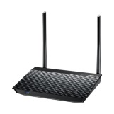
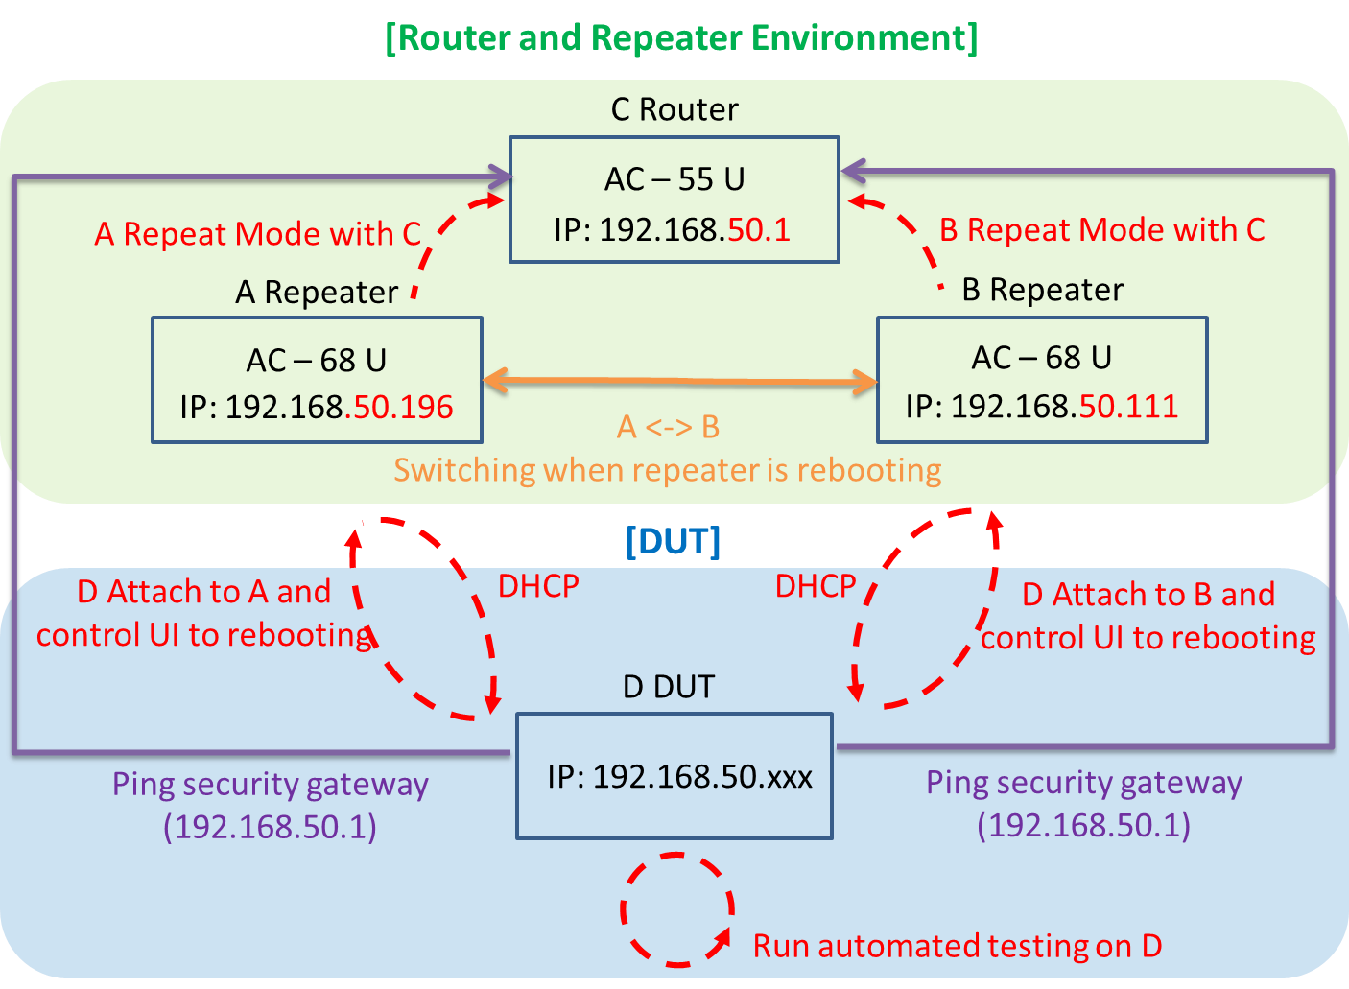
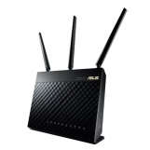
Roaming Automation
System Structure

Slide 7
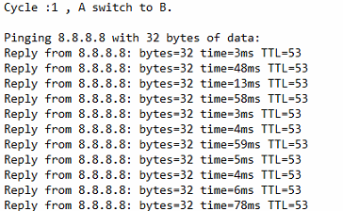
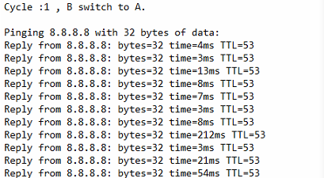
Roaming Automation
The roaming’s ping log are as below:

Slide 8
Wi-Fi Frequency Switch Automation
Demand
In order to fine-tune the switch function of the [N Only] and [Legacy] based on Wi-Fi AP switch of 2.4G.
In order to fine-tune the switch function of the [N/AC mixed] and [Legacy] based on Wi-Fi AP switch of 5G.
Improvement
Load testing of 2.4G and 5G.

Slide 9
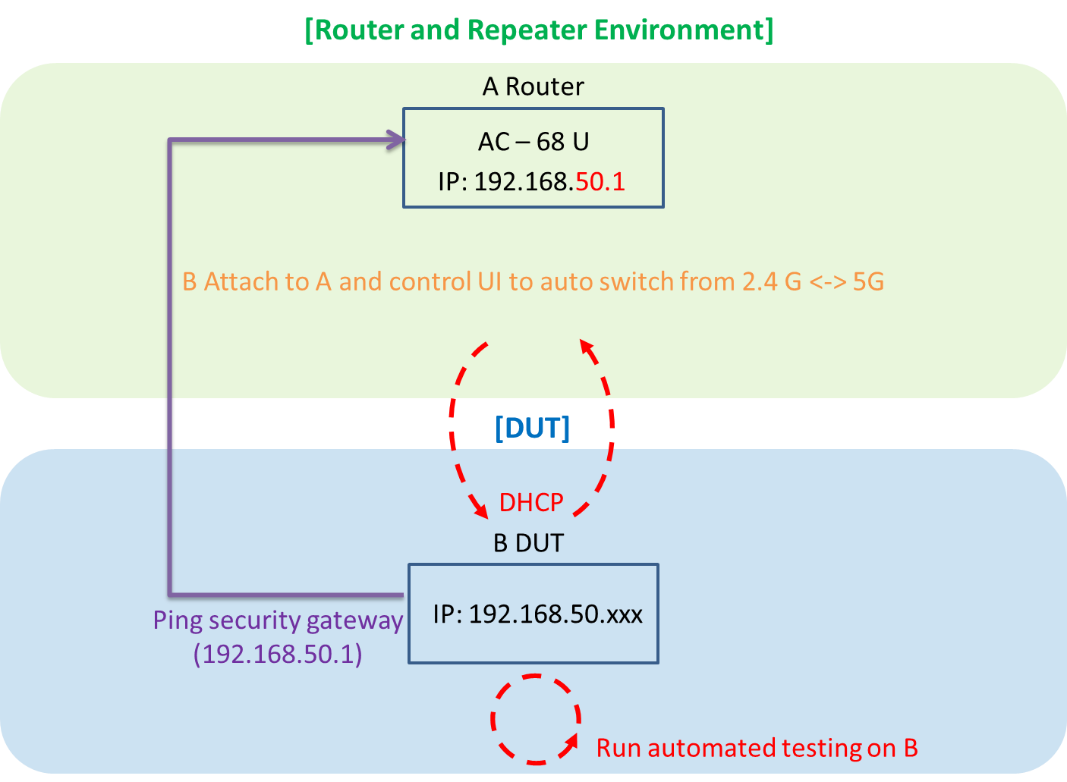
Wi-Fi frequency switch automation
System Structure

Slide 10
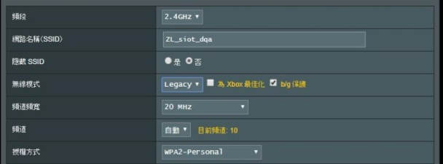
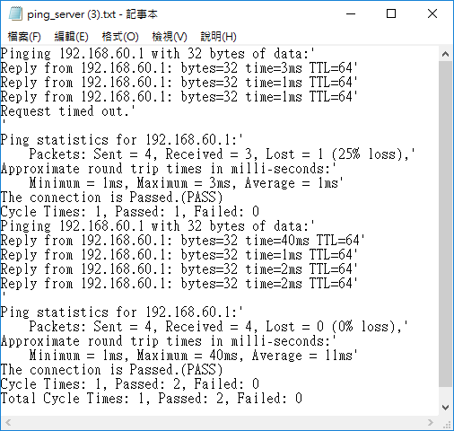
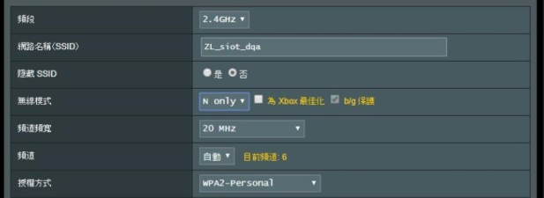
Wi-Fi frequency switch automation
The Wi-Fi switch’s screenshot and log are as below:

Slide 11
Airplane ON/OFF Mode Automation
Demand
Improvement
Finish the airplane switch on/off mode stability by load testing.

Slide 12
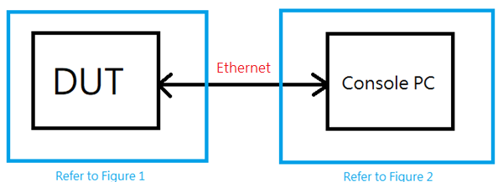
Airplane ON/OFF Mode Automation(Android, RJ45)
Android 6.0.1 or 8.0.1 for WLAN and WWAN
Block Diagram

Slide 13
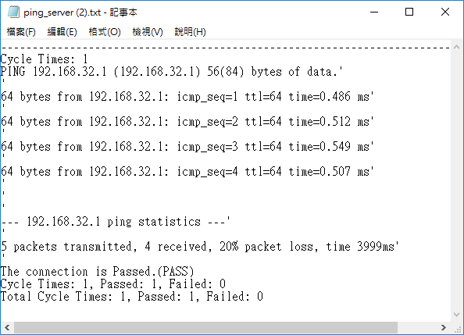
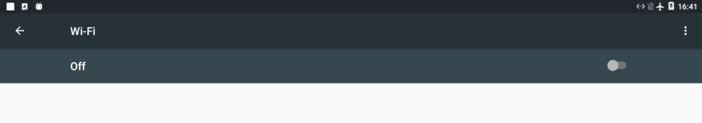
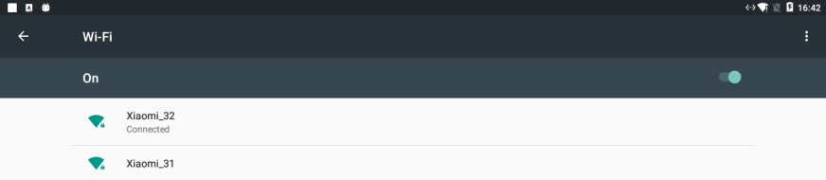
Airplane ON/OFF Mode Automation(Android, RJ45)
The output screenshot and log are as below.
Airplane ON (Wi-Fi OFF)
Airplane OFF (Wi-Fi ON)

Slide 14
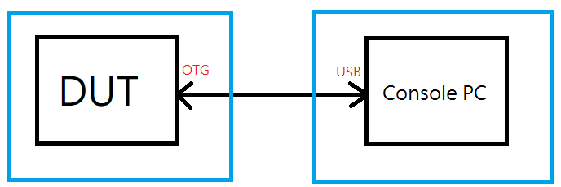
Airplane ON/OFF Mode Automation(Android, OTG)
Android 6.0.1 or 8.0.1 for WLAN and WWAN
Block Diagram

Slide 15
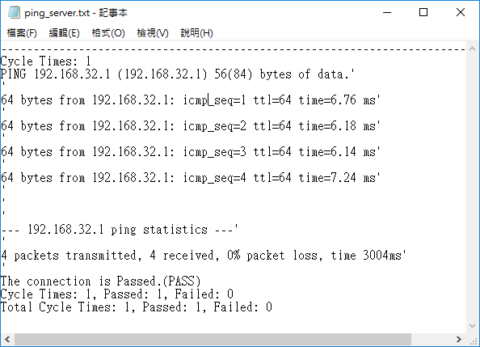
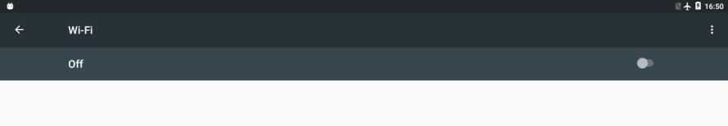
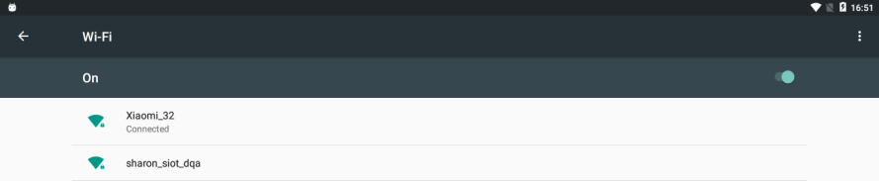
Airplane ON/OFF Mode Automation(Android, OTG)
The output screenshot and log are as below.
Airplane OFF (Wi-Fi ON)
Airplane ON (Wi-Fi OFF)

Slide 16


Airplane ON/OFF Mode Automation(Windows)
Windows for WLAN
The test script base on Sikuli API under the windows environment.
Airplane ON/OFF Mode Automation

Slide 17
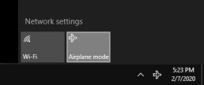
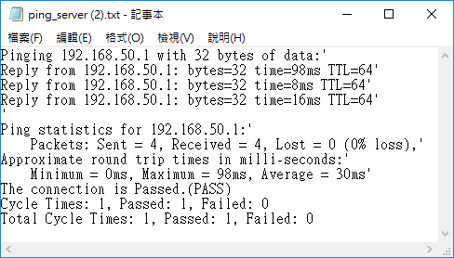
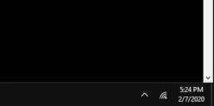
Airplane ON/OFF Mode Automation(Windows)
The output screenshot and log as below.
Airplane OFF (Wi-Fi ON)
Airplane ON (Wi-Fi OFF)

Slide 18
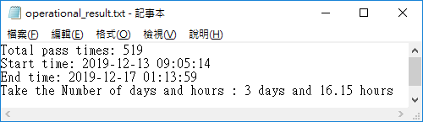
PXE automatic installation
Demand
Improvement
Automatic process/procedure installing the Windows OS.
Load testing of long-term automatically install.
Operation system installation.
Notes:
需求
解決人工沒有辦法執行這件事情
改善
時程上做改善
現在可以透過 Legacy 跟 UEFI 安裝
自動重複化安裝 Windows OS 程序
長時間自動安裝壓力測試

Slide 19
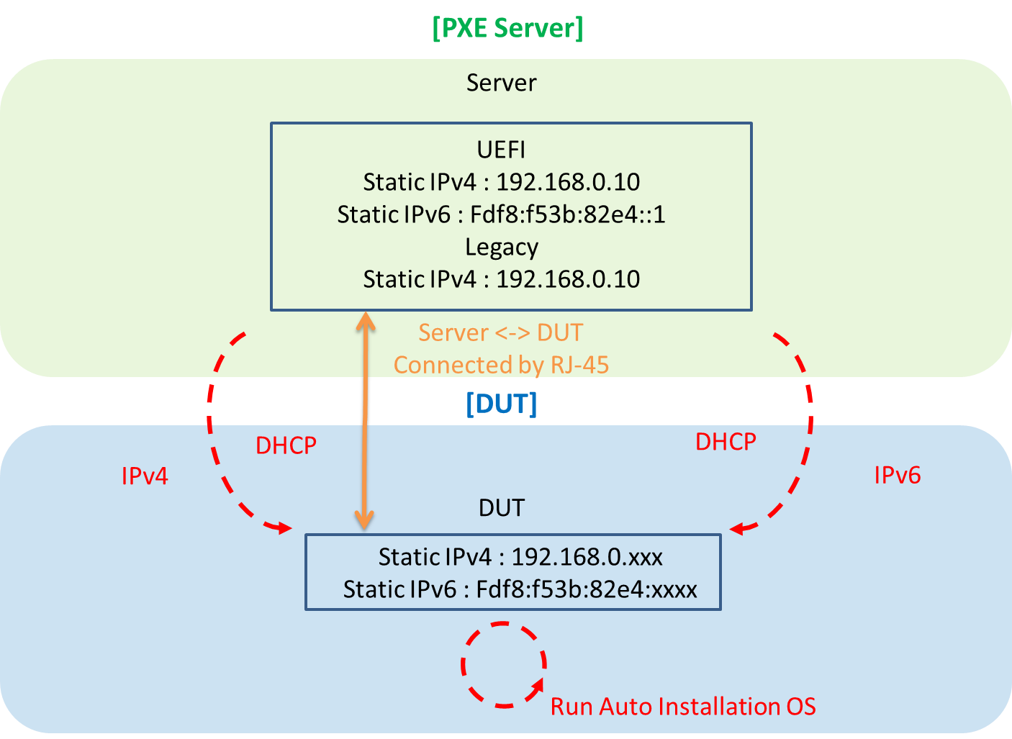
PXE automatic installation
System Structure

Slide 20
Luminance automation
Demand
Improvement
Develop a production program according to the product requirements and spec.
Fast generate picture and write program to measure the panel.

Slide 21
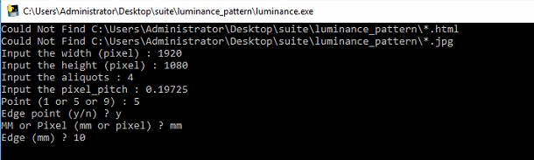
Luminance automation
The tool of pre-condition base on the product specification.

Slide 22

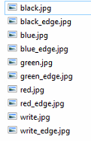
Luminance automation
The output luminance photo.

Slide 23
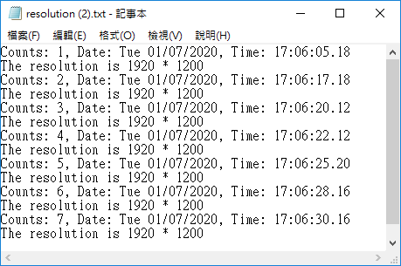
Resolution Automation
Demand
Improvement
Automatically capture the GPU resolution of the host/mainframe with auto testing process.
Reboot with long period to capture resolution.
The Tool base on the GPU resolution
Auto catch the resolution by batch code.
(Reboot)

Slide 24
ProgramIndex automation
Demand
Improvement
Download corresponding programs using ProgramIndex.
Extract data/files on FTP Server and download right away.

Slide 25
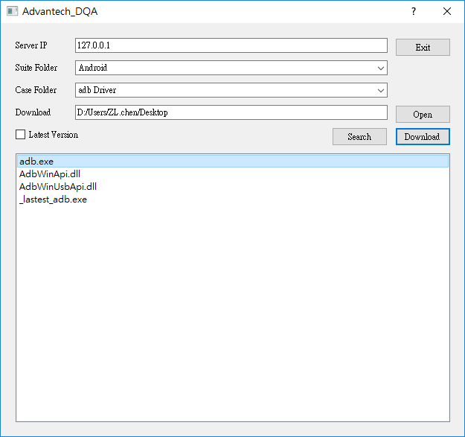
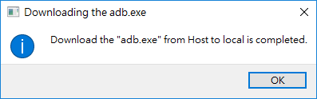
ProgramIndex automation
Download the file by ProgramIndex user interface.
Server IP
Suite Folder
Case Folder
Downlod

Slide 26






Continuous Integration
User
DUT
4. Run Test Script
1. Connect
3. Execute Test Script
5. Console Response
2. Trigger Jobs
6. Feedback Result
7. Mail
PC
CI Server
Test Cases Server

Slide 27
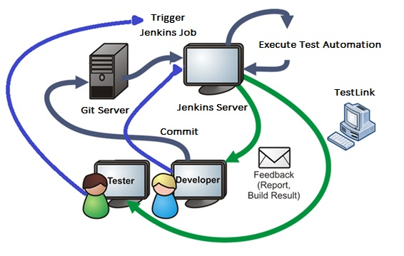
Continuous Integration
Notes:
未來的願景 CI

Slide 28
Go Together,
We Go Far and Grow Big

